Slide 1
Probability Using Distributions

Slide 2
Random Variables
Random variables are variables that represent the outcomes of a random process or experiment
They assign a numerical value to each possible outcome of a random phenomenon, and its value depends on chance.
The probability of a variable taking a certain value / range of values is given by its “probability distribution”
Discrete random variables distribution is given by a probability mass function, while continuous random variables are specified by a probability density function

Slide 3
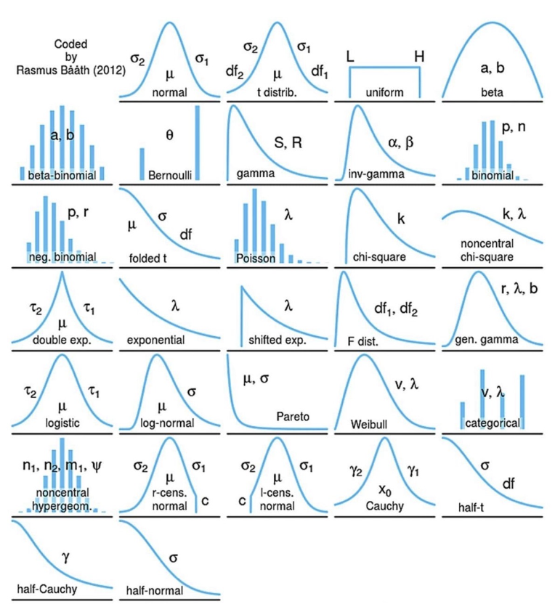
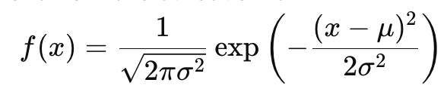
Probability Distributions
Probability distributions are mathematical formulas that specify the likelihood of a random variable taking on specific values given specific parameters.

Slide 4
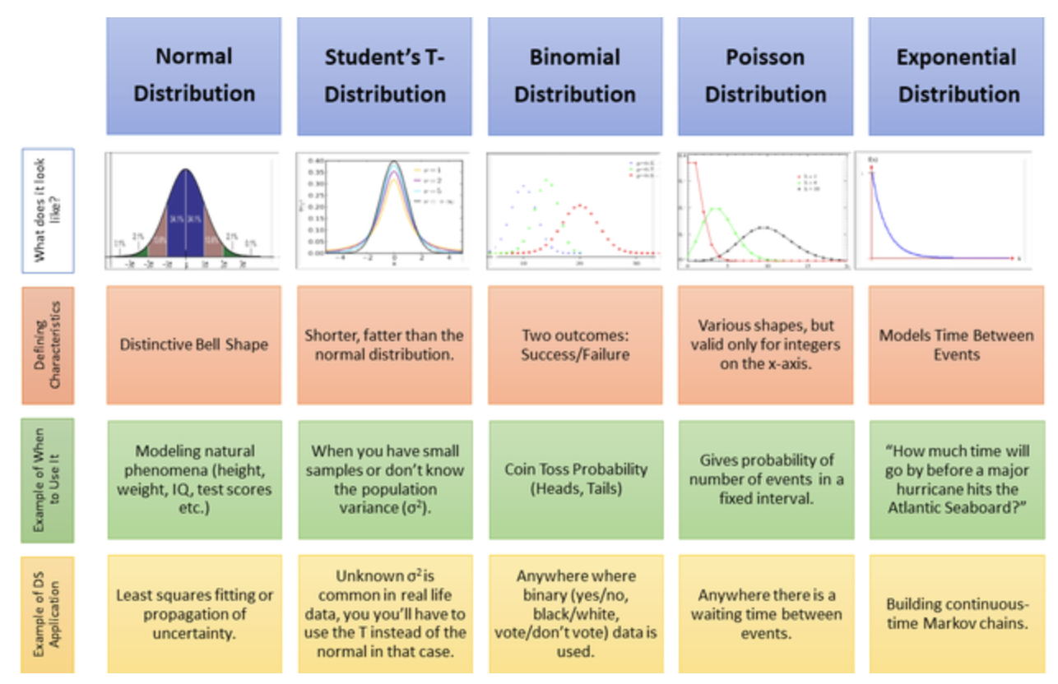

Slide 5
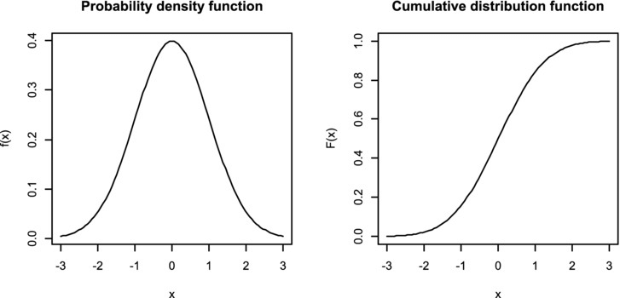
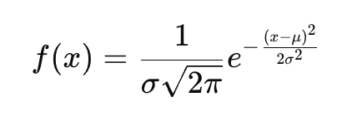
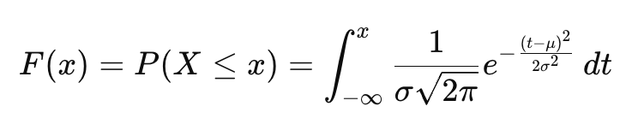
PDF vs CDF
Probability Density Function: provides the likelihood of a random variable taking a range of values. Area under curve sums to 1. Height = Density.
Cumulative Density Function: shows the probability that random variable will take a value less than or equal to a given value. Height = Probability

Slide 6
Continuous Probability Distributions
The Uniform, Normal, and Standardized Normal Distributions

Slide 7
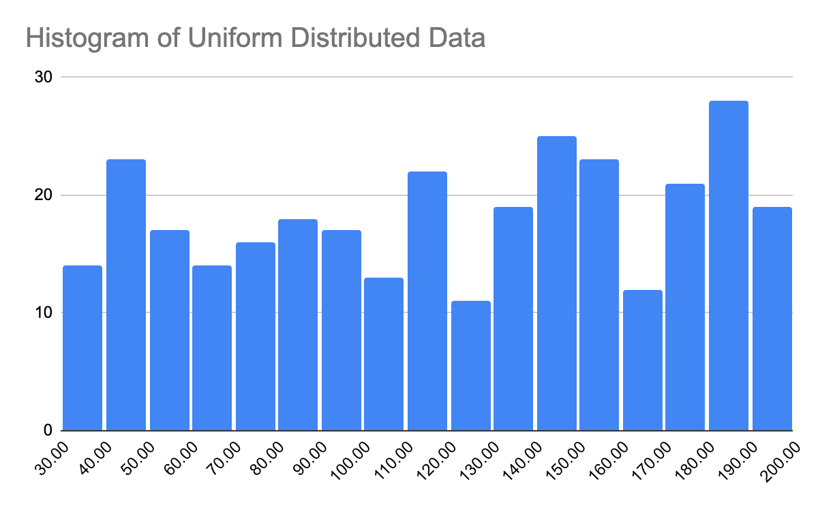
Uniform Distribution
Each value in the interval has an equal probability of occurrence
A = minimum value of distribution, B = maximum value of distribution
XL = minimum bound of interval, XH = maximum bound of interval
P(XL < x < XH) = (XH - XL) / (B - A)
Mean = (A + B) / 2
Max: 200, Min: 30…Mean = 115
P(100 < x < 150) = 50 / 170 = 29.4%
29.4%

Slide 8

Uniform Distribution Example
A video game “spawns” an enemy in a random location along a 500 meter span of map.
What is the probability that an enemy is spawned into the last 50 meters of the 500 meter map (so between meter 450 and 500)?
P(XL < x < XH) = (XH - XL) / (B - A)
XL = 450, XH = 500, A = 0, B= 500
(500 - 450) / (500 - 0) = 50 / 500 = 10%

Slide 9
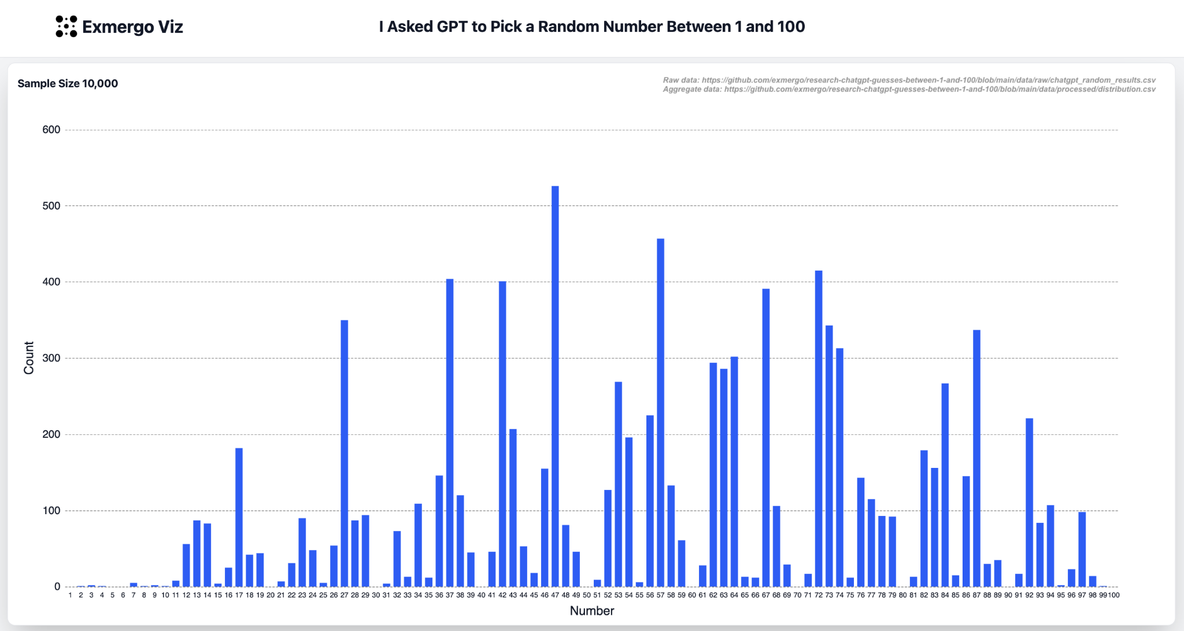
LLMs vs PRNGs
Computers typically use pseudo-random number generators
True randomness can’t be deterministically programmed, but it can be faked pretty well using complex formulas and semi-random inputs (system clock, your seed selection, even lava lamps)!
LLMs, by contrast, generate “randomness” poorly as they are using the weighted average of their training sets and people aren’t random.

Slide 10

Lava Lamps at Cloudflare HQ

Slide 11
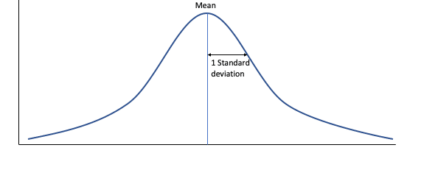
The Normal Distribution
Characteristics:
Centered on the mean value of the data
Mean = Median = Mode = Peak of Curve
Symmetrical - 50% of the data are above the mean and 50% are below the mean
Width determined by the standard deviation of the data

Slide 12
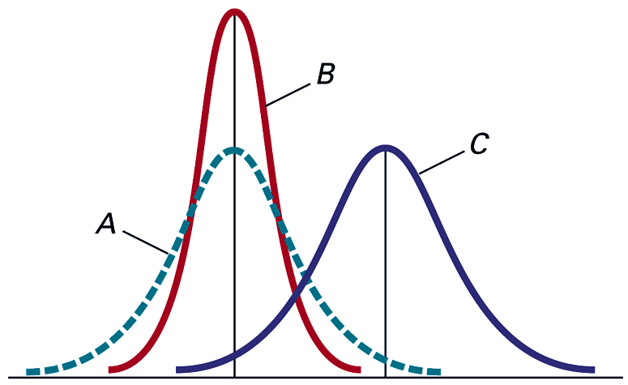
The Normal Distribution
Distributions A and B have the same mean value, but A has a larger standard deviation than B
Distributions A and C have the same standard deviation, but C has a larger mean than A

Slide 13
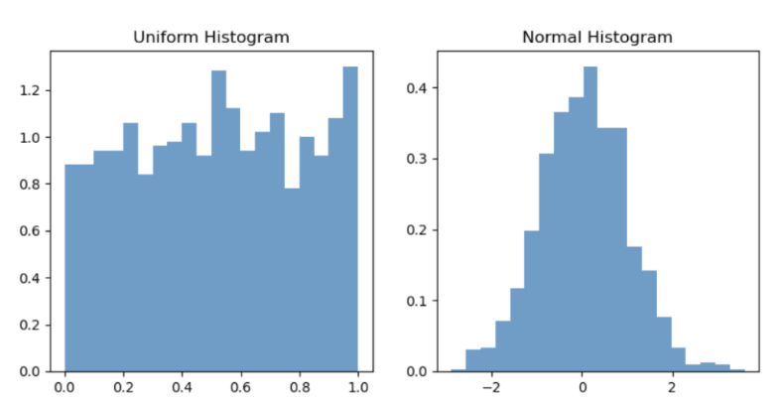
Is Your Data Normally Distributed?
For the upcoming methodology to work correctly, the data you’re analyzing must be (roughly / approximately) normally distributed?
How to tell if the data are normally distributed:
Histogram
Q-Q Plot*
Statistical test - Shapiro-Wilk*

Slide 14
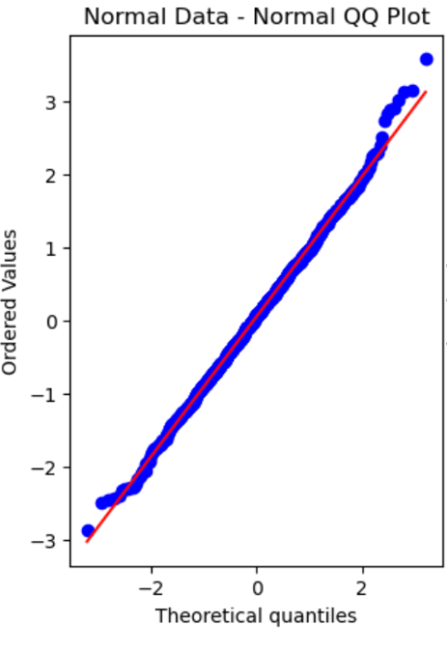
Q-Q Plots
Q-Q plots compare the distribution of your data with a theoretical distribution of your choosing.
Your data’s distribution is shown on the Y-axis and the theoretical distribution is shown on the X-axis.
A 45 degree line runs across the plot diagonally.
Points will fall on the line to the extent that the actual data matches up with the theoretical distribution

Slide 15
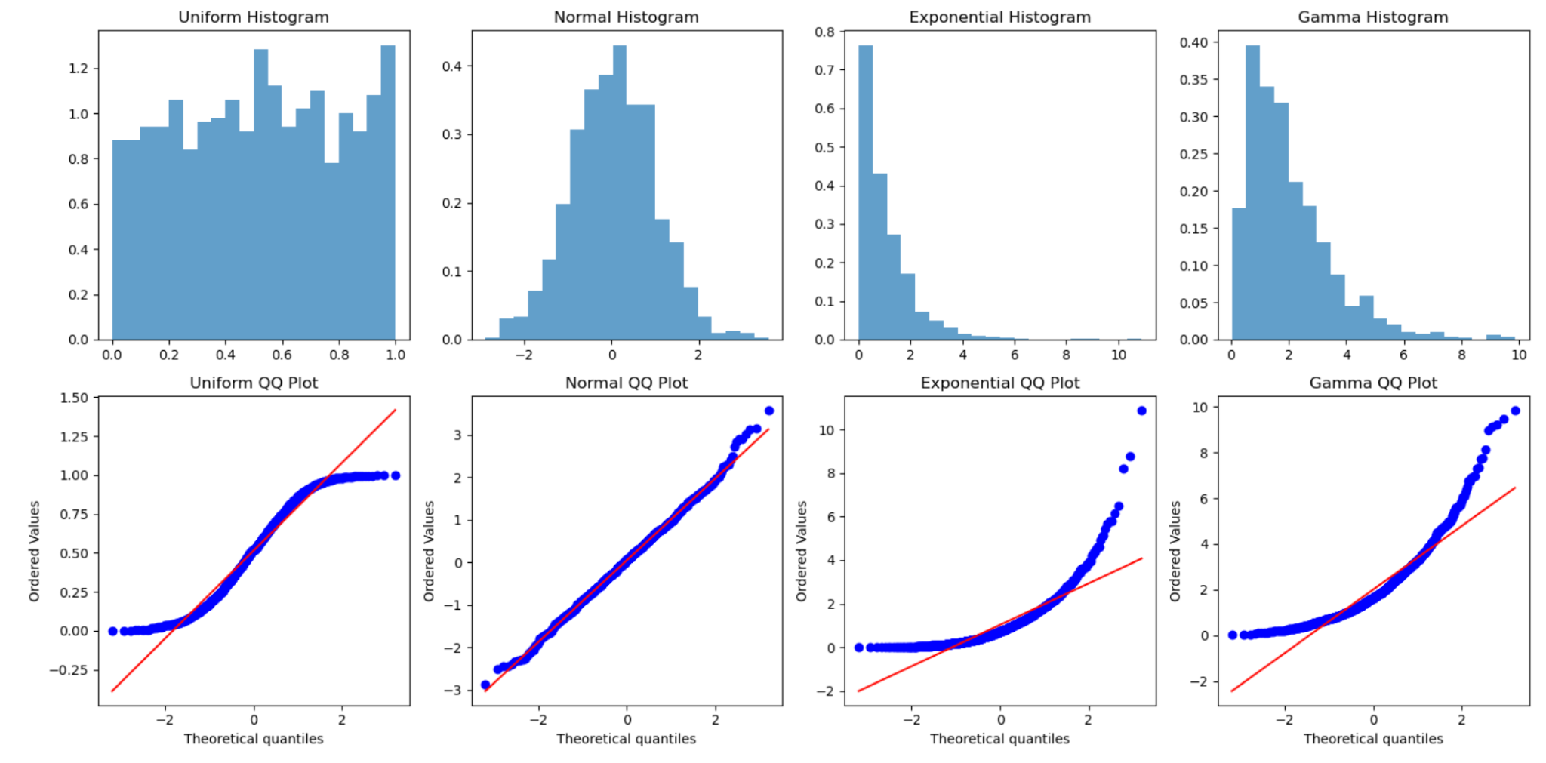

Slide 16
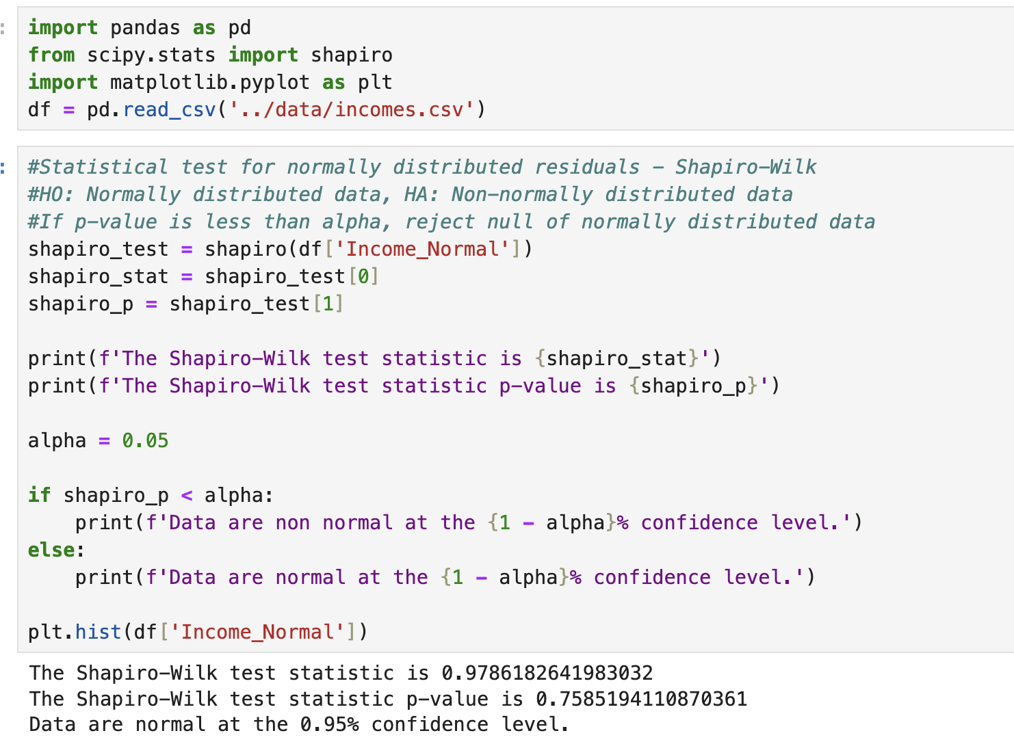
Shapiro-Wilk
H0: Normally Distributed Data
HA: Non-Normally Distributed Data
Alpha = 1 - Confidence Level
If p-value is less than alpha, reject the null hypothesis that the data are normally distributed
May or may not be a valid procedure*

Slide 17
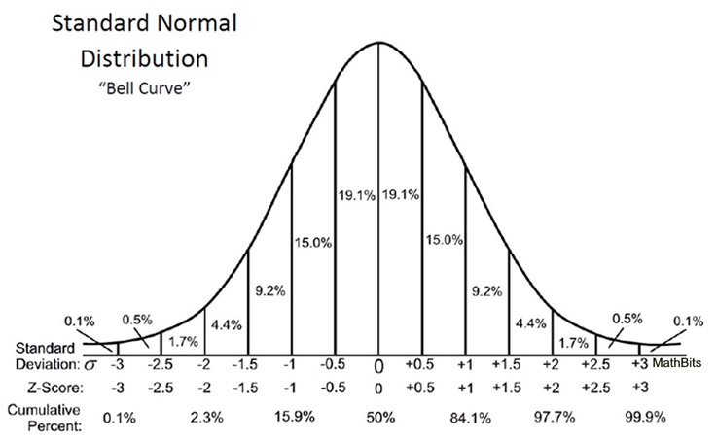
The Standardized Normal Distribution
The standardized normal distribution is a special case of the normal distribution
Mean = 0
Standard Deviation = 1
Any normally distributed data can be converted to the standardized normal distribution using the Z formula
Z = (X - Mean) / Standard Deviation
Z = # of standard deviations away from the mean
Z is negative if below the mean and positive if above

Slide 19
Z
Z = (X - Mean) / Standard Deviation
If we have a series with a mean of 50 and a standard deviation of 15, what is the Z value for the number 18
Z = (18 - 50) / 15 = -1.77
Interpretation: 18 is 1.77 standard deviations below the mean

Slide 20
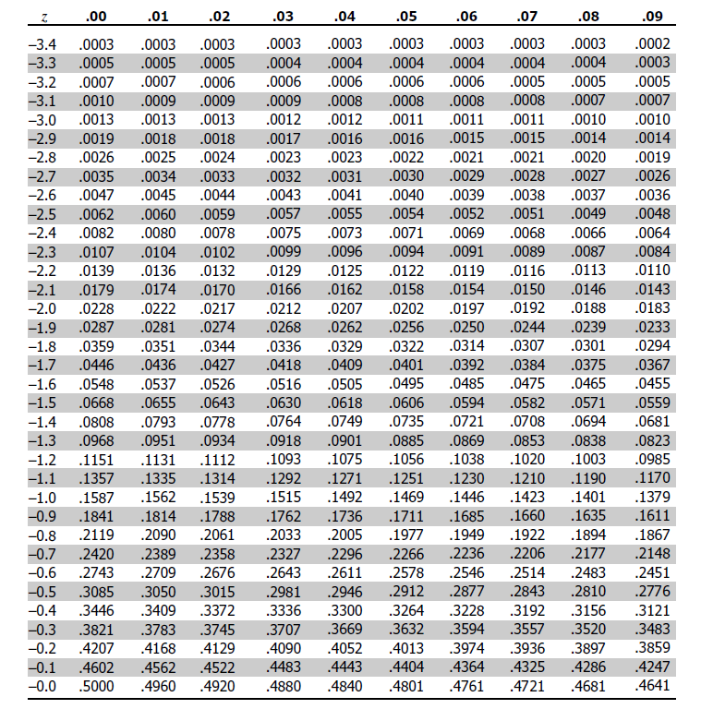
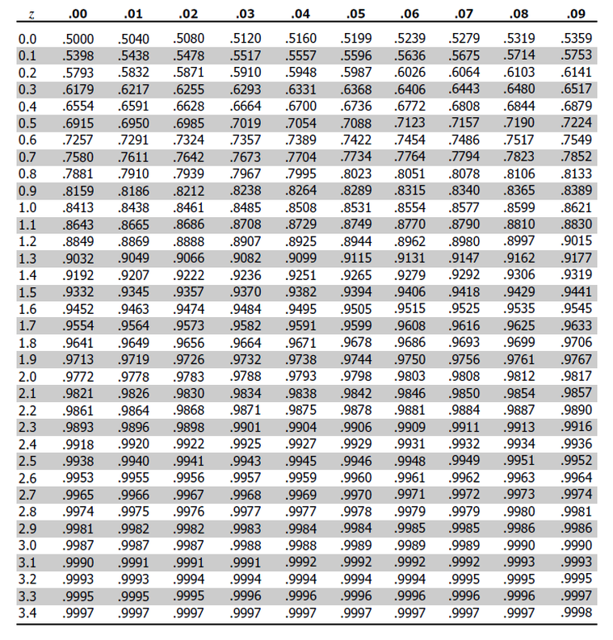
Why convert to the standardized normal distribution?
So that we can use pre-calculated probabilities (area under the curve) from a Z table / statistics software!

Slide 21
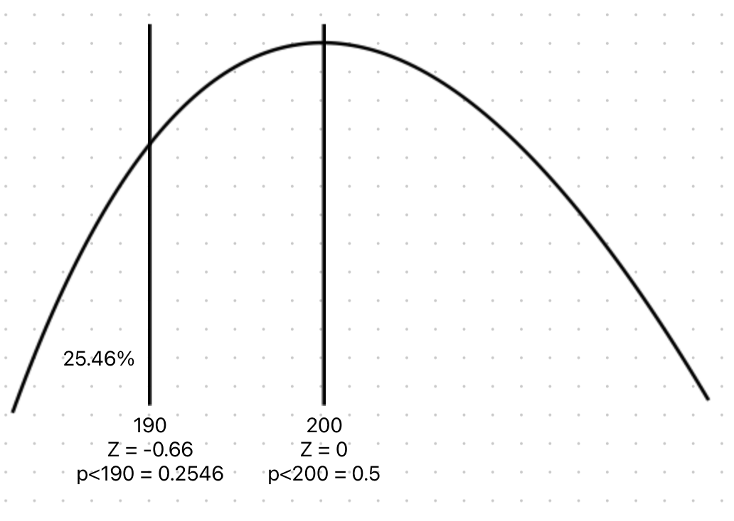
Probabilities Using Z - p(x<X)
Given normally distributed monthly sales data with a mean of 200 and a standard deviation of 15, what is the probability of selling less than 190 units on any given month?
Z = (190-200)/15 = –0.66
p(x<190) = .2546

Slide 22
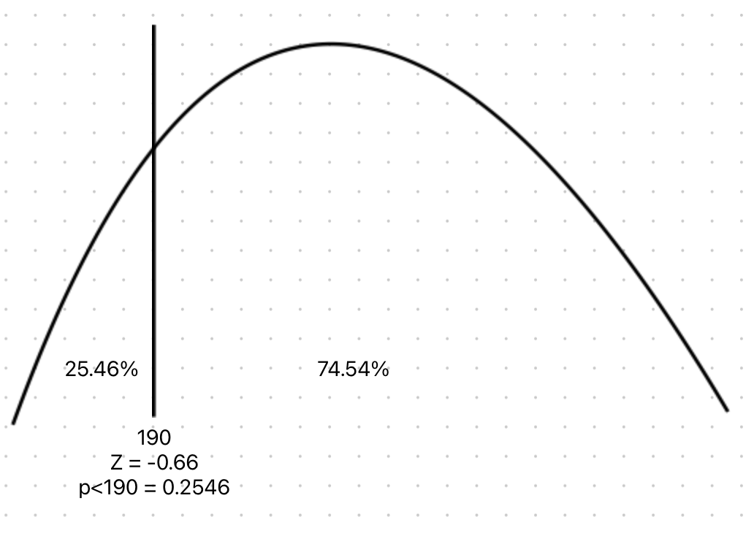
Probabilities Using Z - p(x>X)
Given normally distributed monthly sales data with a mean of 200 and a standard deviation of 15, what is the probability of selling more than 190 units on any given month?
Z = (190-200)/15 = –0.66
p(x<190) = .2546
p(x>190) = 1 - .2546 = .7454 = 74.54%

Slide 23
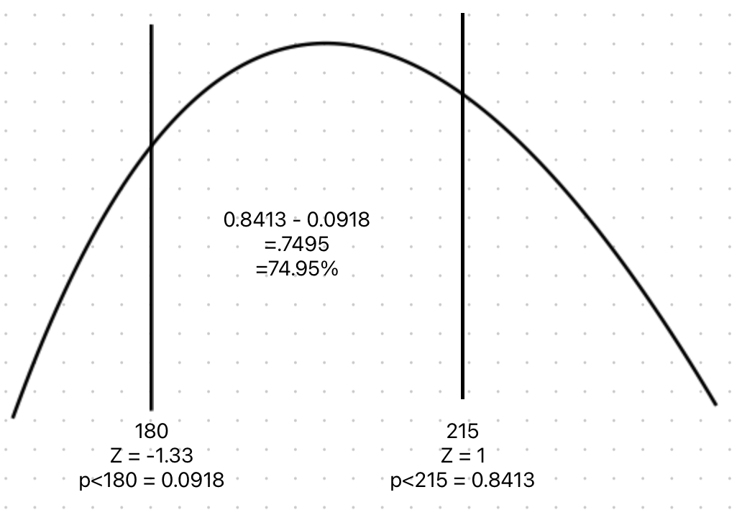
Probabilities Using Z - p(XL<x<XH)
Given normally distributed monthly sales data with a mean of 200 and a standard deviation of 15, what is the probability of selling between 180 and 215?
Z = (180-200)/15 = –1.33
p(<180) = 0.0918
Z = (215-200)/15 = 1
p(<215) = 0.8413
= 74.95%

Slide 24
Finding X, Given the Probability
Z = (X - Mean) / Stdev
With a little algebra, we can solve for X
X = Mean + Z * Stdev
Given normally distributed data with a mean of 100 and standard deviation of 15, what value of X will be greater than 40% of the data
Find 40% in the table = Z = -.25
X = 100 -.25*15
X = 100 - 3.75
X = 96.25

Slide 25
Normal Distribution in Excel
=standardize(x, mean, stdev) to find Z
=norm.dist(x, mean, stdev, TRUE) for <=
=1 - norm.dist(x, mean, stdev, TRUE) for >
=norm.dist(XH, mean, stdev, TRUE) - norm.dist(XL, mean, stdev, TRUE) for XL<x<XH
To generate random normally distributed data, =norm.inv(rand(),mean,stdev)
To generate uniformly distributed data =rand() or =randbetween(low, high)

Slide 26
Example Problems
IQ has a mean of 100 and a standard deviation of 15
What is the probability of having an IQ greater than 140?
Female height has a mean of 64.5 inches and a standard deviation of 2.5 inches
What is the probability of a woman being shorter than 60 inches?
Monthly sales have a mean of 500 and a standard deviation of 125
What is the probability of selling between 300 and 400 units next month?

Slide 27
Discrete Probability Distributions
Binomial and Poisson

Slide 28
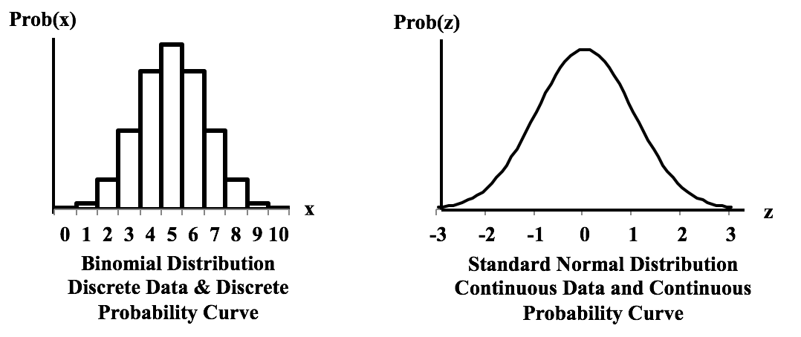
Discrete vs Continuous
Discrete only takes on whole number values and is typically a count.
Continuous takes any value within an interval and is typically a measure.

Slide 29
Factorials!
The factorial of a number is the product of that number multiplied by all of the positive integers below it
n! = n * (n-1) * (n-2)...3 * 2 * 1
5! = 5 x 4 x 3 x 2 x 1 = 120
1! = 1
0! = 1

Slide 30
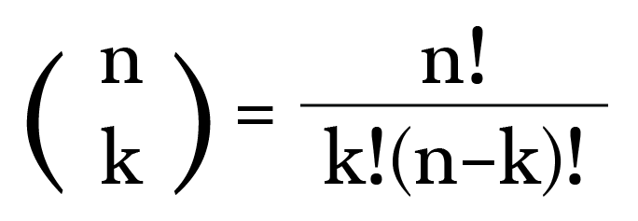
Combinations
How many groups of k size can be made from a set of n items?
How many ways can 5 cards be drawn from a deck of 52?
52! / 5!*47!...
Use a calculator / computer!
=2,598,960

Slide 31
Binomial Probability Formula
n
!
P(X=x |n,π)
=
x
n
−
x
π
(1-π)
x!
(
−
)
n
x
!
n = number of events
x = number of successes
pi = probability of success

Slide 32
Binomial Probability
Use to calculate probability of getting a fixed number of successful outcomes in a fixed number of independent trials where each trial has only two possible outcomes
Answers: “What is the probability of x successes in n trials?”
Assumes:
A fixed number of trials
Outcomes are binary
Probability of success is constant across trials
Trials are independent
Trials are identical
Could be used to estimate the probabilities of:
A certain number of customers purchasing a car
A certain number of defaults in a portfolio of loans
A certain number of defective products in a production process
A certain number of successful treatments of sick patients

Slide 33
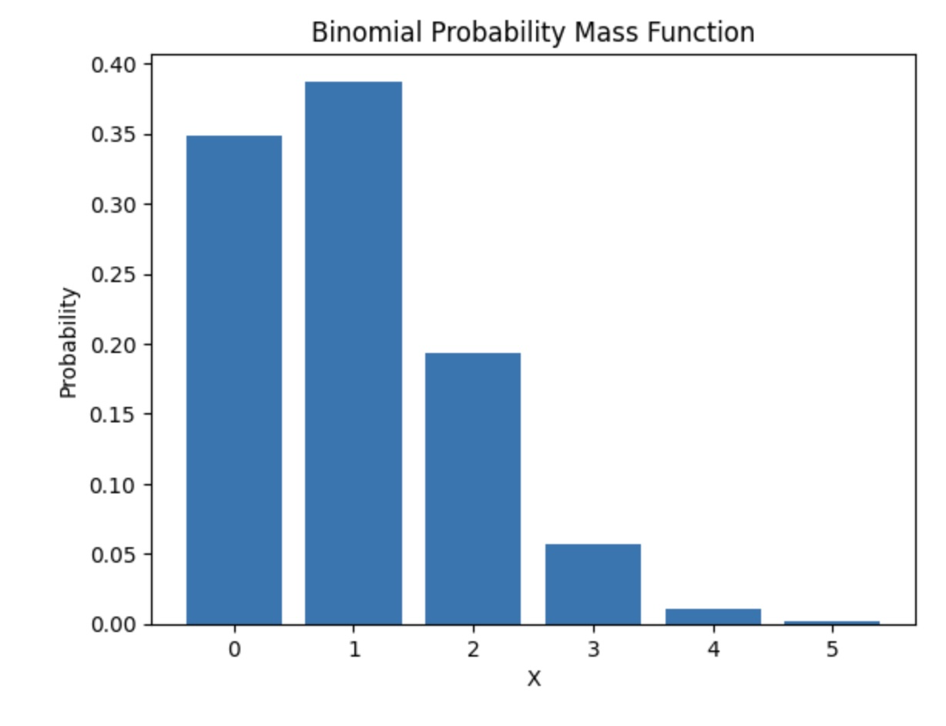

Slide 34
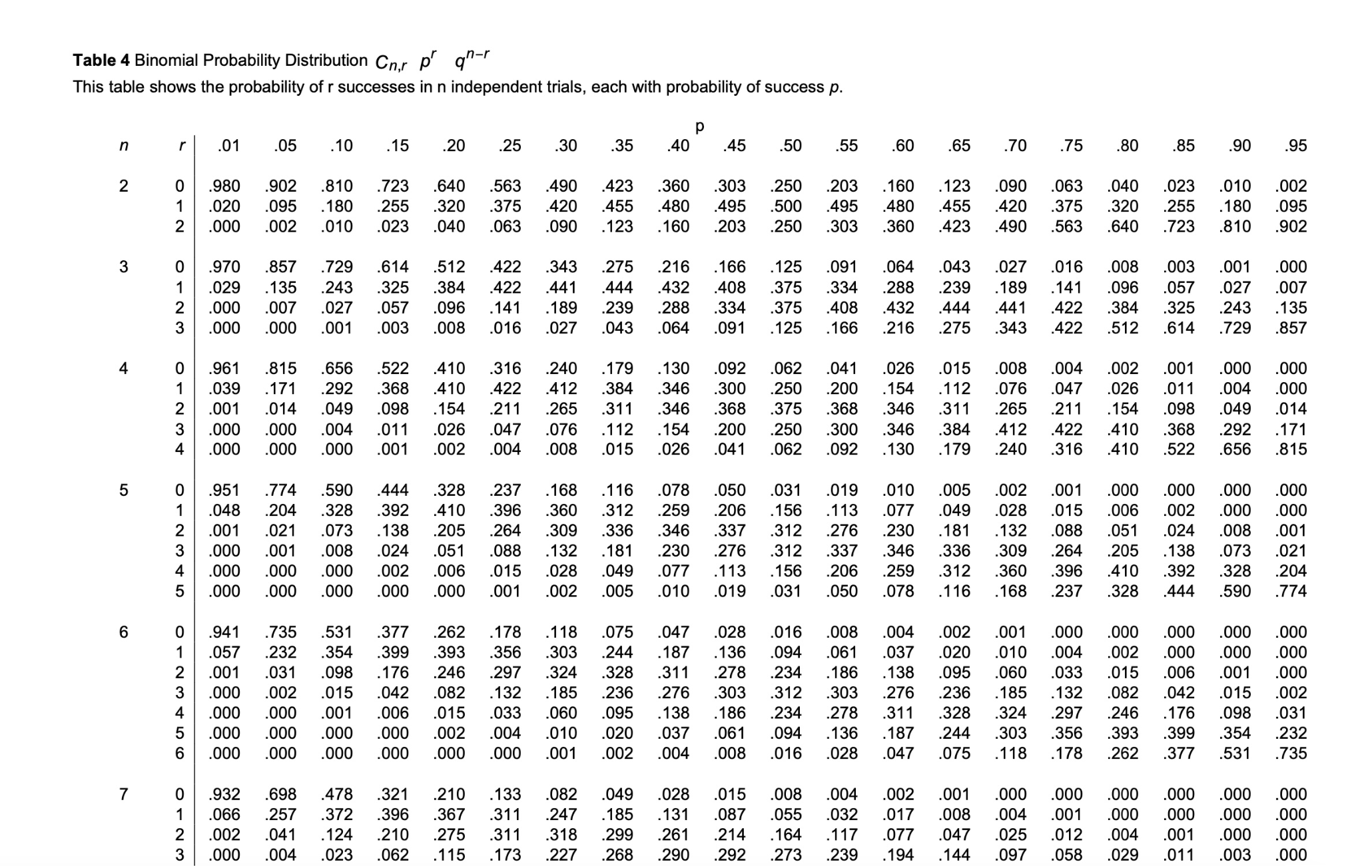

Slide 35
Binomial Probability
n
!
P(X=x |n,π)
=
x
n
−
x
π
(1-π)
x!
(
−
)
n
x
!
What is the probability of getting two heads in a series of five coin flips?
n =5, x = 2, pi = 0.5

Slide 36
Binomial in Excel
=binom.dist(x, # of trials, probability of success, False) for specific values
=binom.dist(x, # of trials, probability of success,True) for <=
=1 - binom.dist(x, # of trials, probability of success, True) for >

Slide 37
What is the probability of getting two heads in a series of 5 coin flips?
n =5, x = 2, pi = 0.5
= 0.312
p(x<2)?
p(0) + p(1)
0.031 + 0.156 = 0.187 = 18.7%
p(x>=2)?
1 - 0.187 = .813 = 81.3%

Slide 38
Binomial Probability Problems
Given a 10% chance of default and 6 loans, what is the probability of
5 defaults (=): Calculate p(5)
Less than 5 defaults (<):
Calculate p(0) + p(1) + p(2) + p(3) + p(4)
5 of less defaults (<=):
Calculate p(0) + p(1) + p(2) + p(3) + p(4) + p(5)
More than 5 defaults (>):
Calculate 1 - [p(0) + p(1) + p(2) + p(3) + p(4) + p(5)]
5 or more defaults (>=):
Calculate 1 - [p(0) + p(1) + p(2) + p(3) + p(4)]

Slide 39
Example Problems
You’re an attorney with a client facing seven charges. There is a one percent chance of conviction for each charge. What is the probability that your client will face at least one conviction?
P(1) + P(2) + P(3) + P(4) + P(5) + P(6) + P(7)
or
1 - P(0)
= 6.7%

Slide 40
Binomial Distribution Statistics
n = number of trials
p = probability of success
mean = n * p
standard deviation = sqrt(n*p*(1-p))

Slide 41
Poisson Probability
Could be used for estimating the probabilities of a certain number of:
Customers entering a store per hour
Phone calls received by a call center
Employees calling in sick
Potholes in a given length (x width = area) of road.
Use to calculate the probability of a given number of events occurring in a given interval of time or space
Answers: “What is the probability that an event happens x times in a given amount of time or space?”
Assumes:
Events are independent (no clustering)
Average rate is constant
Probability of two events occurring at the exact same time = 0
Mean = Variance*
Unlike binomial, poisson does not require a fixed number of trials.

Slide 42
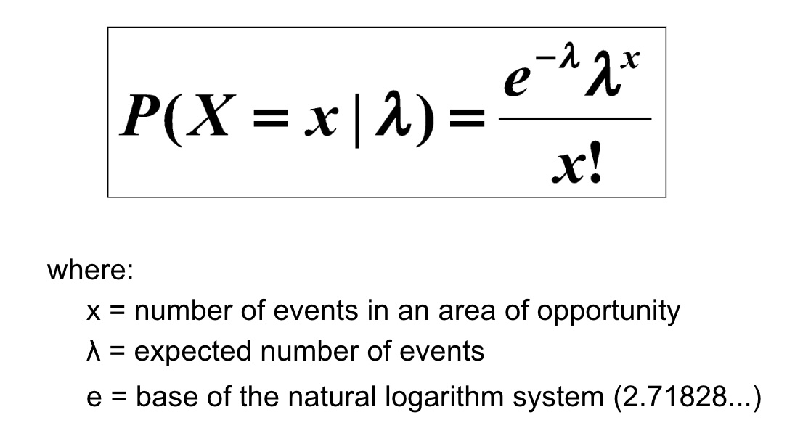
Poisson Probability Formula

Slide 43
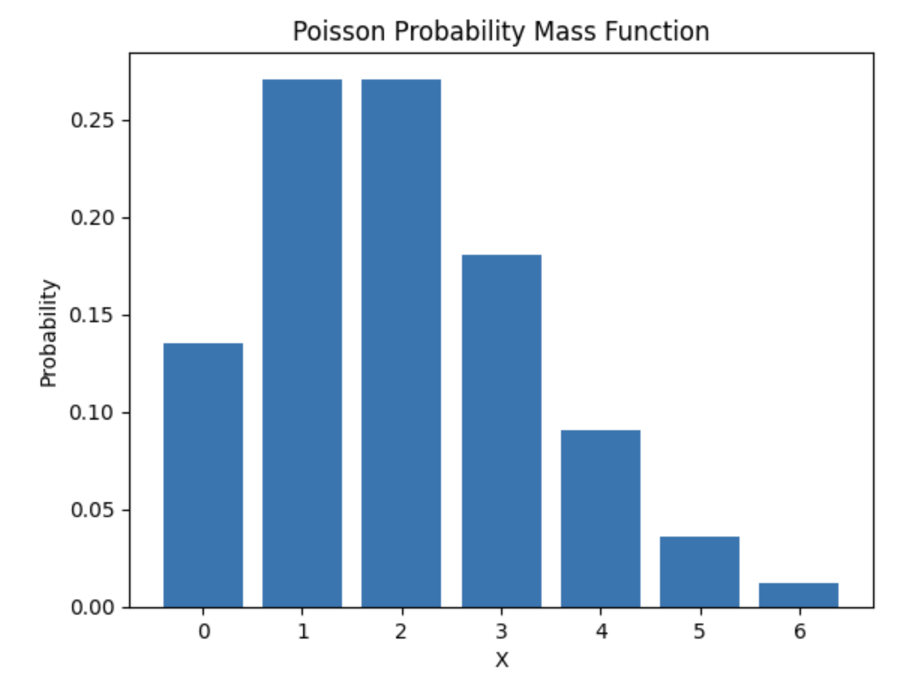

Slide 44
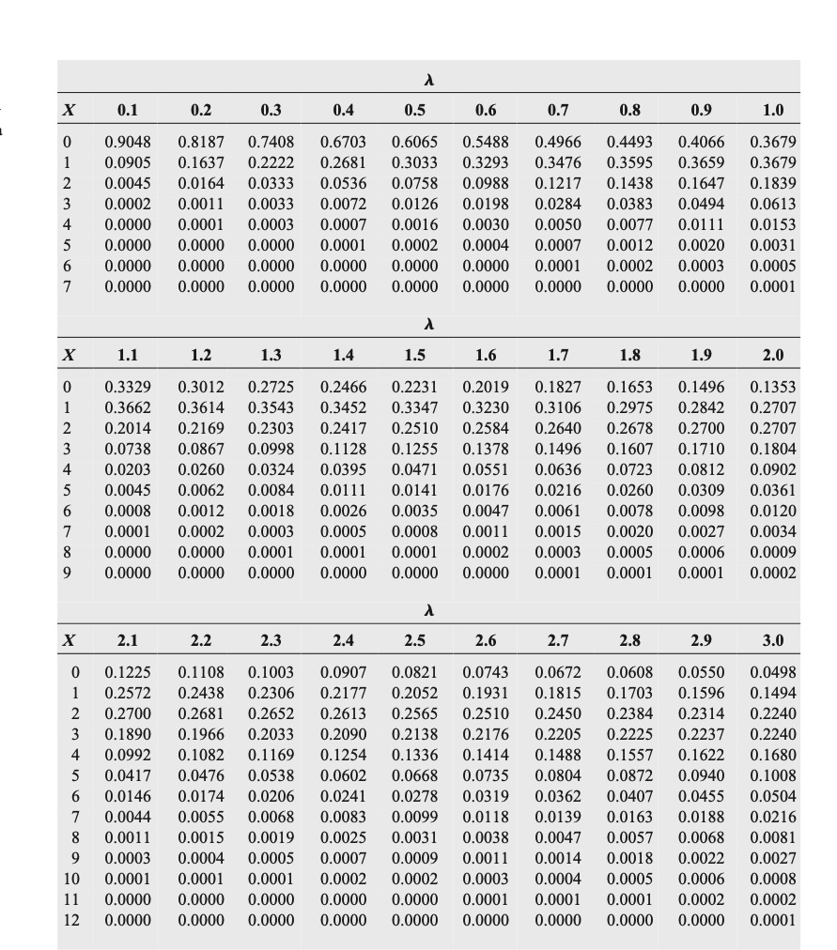
Poisson Distribution Table
Non-Cumulative
(Many pages omitted)
Example:
Average number of calls in an hour is 3
What is p(x=4)?
Find lambda = 3 and x = 4
.1680 = 16.8%
What is p(x<4)?
p(0) + p(1) + p(2) + p(3) = .0498 + .1494 + .2240 + .2240
=.6472 = 64.72%
What is p(x>=4)
= 1 - 0.6472 = .3528 or 35.28%

Slide 45
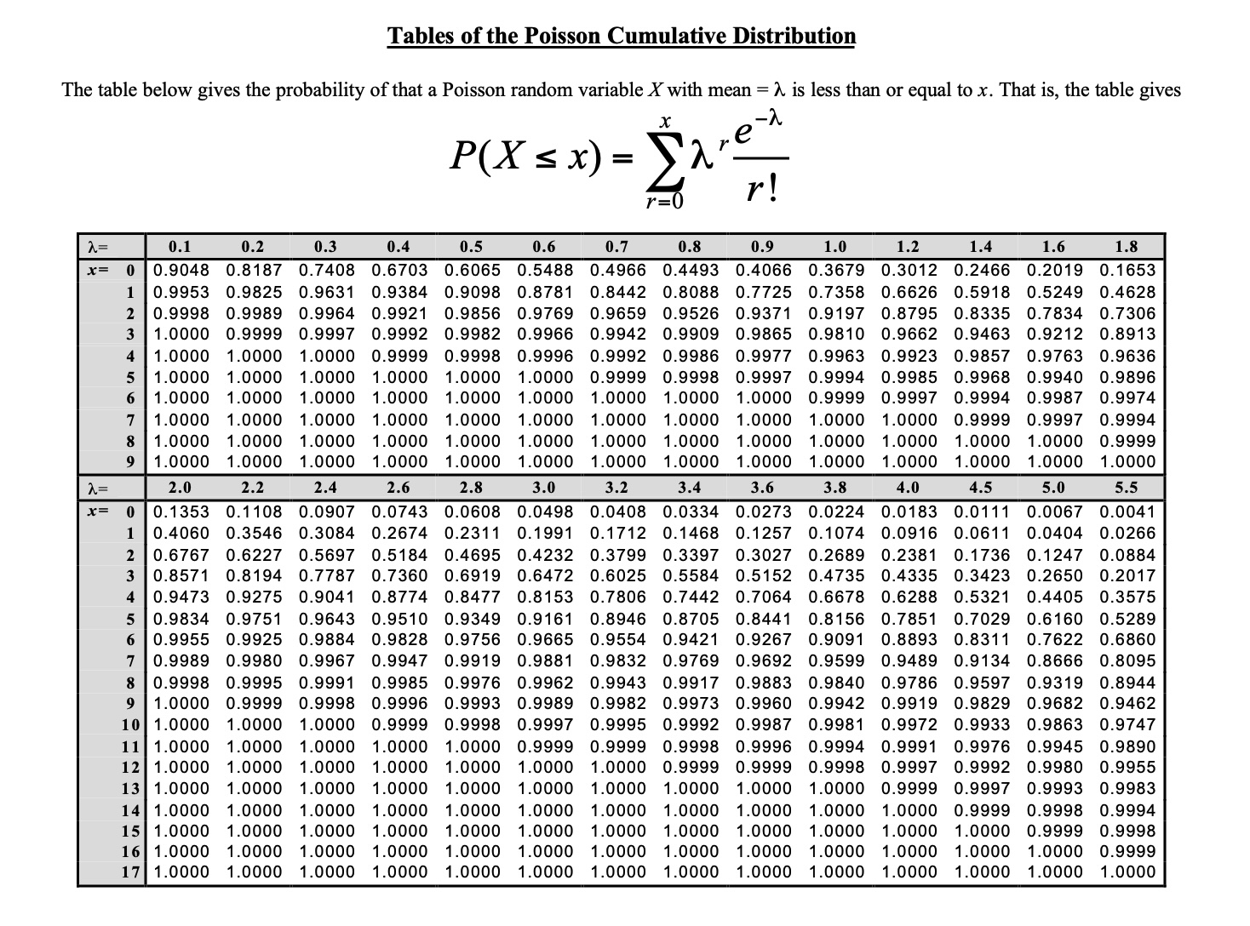
Poisson Distribution Table
Cumulative
(Many pages omitted)
Example:
Average number of calls per hour is 3
What is p(x<4)?
Find lambda = 3 and x = 3
0.6472 or 64.72%
What is p(x>4)
1-.6472 = .3528 = 35.28%

Slide 46
Poisson Probability
What is the probability of getting 10 calls in an hour if the average hourly call rate is 5?

Slide 47
Poisson Probability Problems
Given an average of 10 customers per hour, what is the probability you’ll have
5 customers (=): Calculate p(5)
Less than 5 customers (<):
Calculate p(0) + p(1) + p(2) + p(3) + p(4)
5 of less customers (<=):
Calculate p(0) + p(1) + p(2) + p(3) + p(4) + p(5)
More than 5 customers (>):
Calculate 1 - [p(0) + p(1) + p(2) + p(3) + p(4) + p(5)]
5 of more customers (>=):
Calculate 1 - [p(0) + p(1) + p(2) + p(3) + p(4)]

Slide 48
Poisson In Excel
=poisson.dist(x, mean, False) for specific values
=poisson.dist(x, mean, True) for <=
=1 - poisson.dist(x, mean, True) for >

Slide 49
What if Mean =/= Variance?!
If variance > mean = overdispersion
Use negative binomial distribution or generalized poisson distribution
If variance < mean = underdispersion
Use generalized poisson distribution

Slide 50
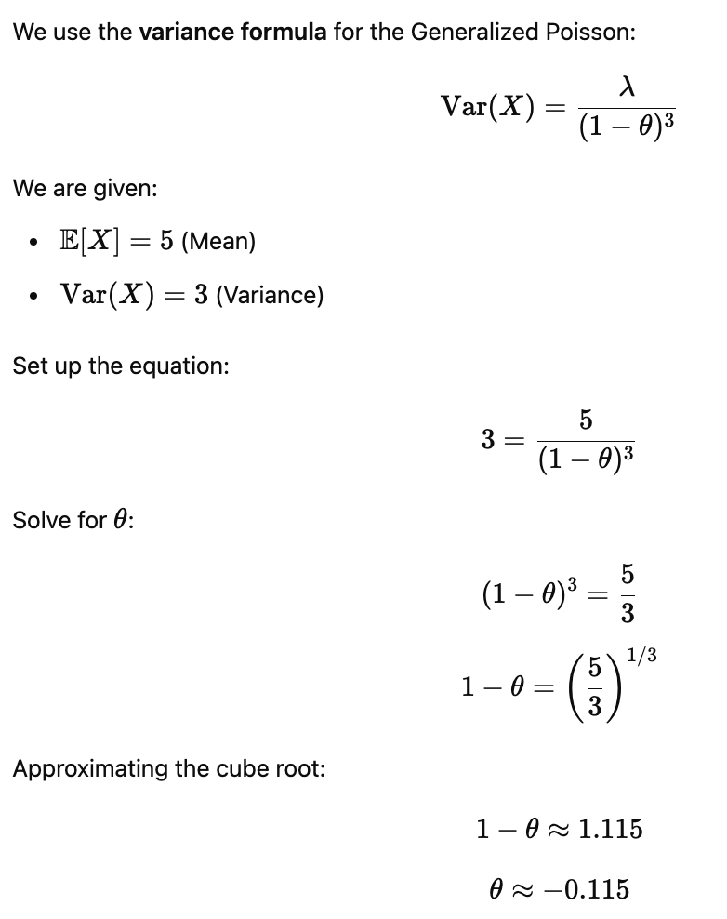
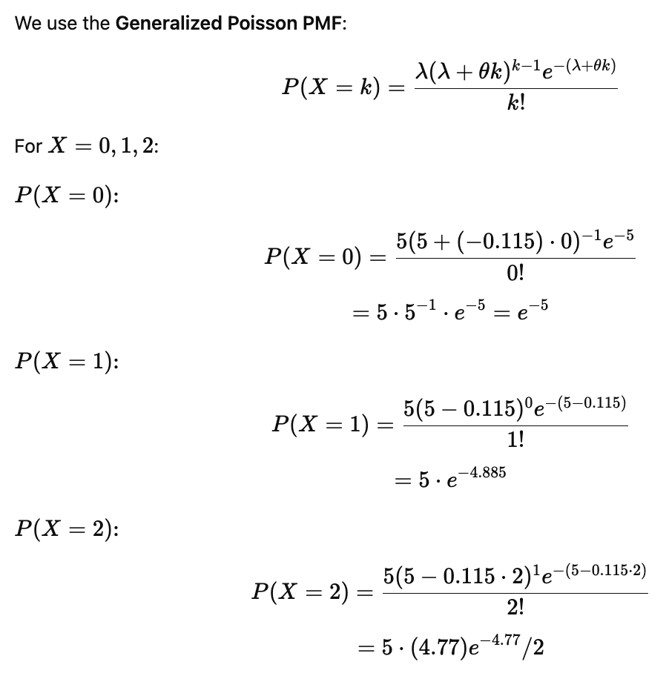
Generalized Poisson

Slide 51
Geometric Distribution
Used to calculate the probability that the first success occurs on a specific trial.
Answers: What is the probability that the first success happens on trial x?
Assumptions:
Outcomes are binary
Probability of success is constant
Trials are independent
Number of trials is not fixed in advance
The experiment continues until the first success
Can be used to estimate:
The trial on which a customer first makes a purchase
The call on which a salesperson first closes a deal
The day on which a machine first fails
The attempt on which a student first passes an exam
The flip on which a coin first lands heads

Slide 52
Geometric Probability Example
What is the probability that the first head occurs on the 4th coin flip?
p = 0.5
x = 4
P(X=4) = [(0.5)^3]*0.5 = 0.0625
Implication: Tails, Tails, Tails, Heads
Extensions:
(1-p)^x-1 = probability of no succes in the first X trials
Complement gives at least one success in first X trials
P(X < x) = 1 - (1 - p)^x-1 (no success after first x trials)
P(X <= x) = 1 - (1 - p)^x (at least one success after first x trials)
P(X > x) = (1 - p)^x (no success in trials 1 - x)
P(X >= x) = (1 - p)^x-1 (first success happens on trial x or later)

Slide 53
Summary of Geometric Distribution Problems
Question | Formula | Interpretation
( X = x ) | ( (1-p)^{x-1}p ) | First success on trial x
( X < x ) | ( 1-(1-p)^{x-1} ) | Success before x
( X = x ) | ( 1-(1-p)^x ) | Success by x
( X > x ) | ( (1-p)^x ) | Still waiting after x
( X >= x ) | ( (1-p)^{x-1} ) | x or later

Slide 54
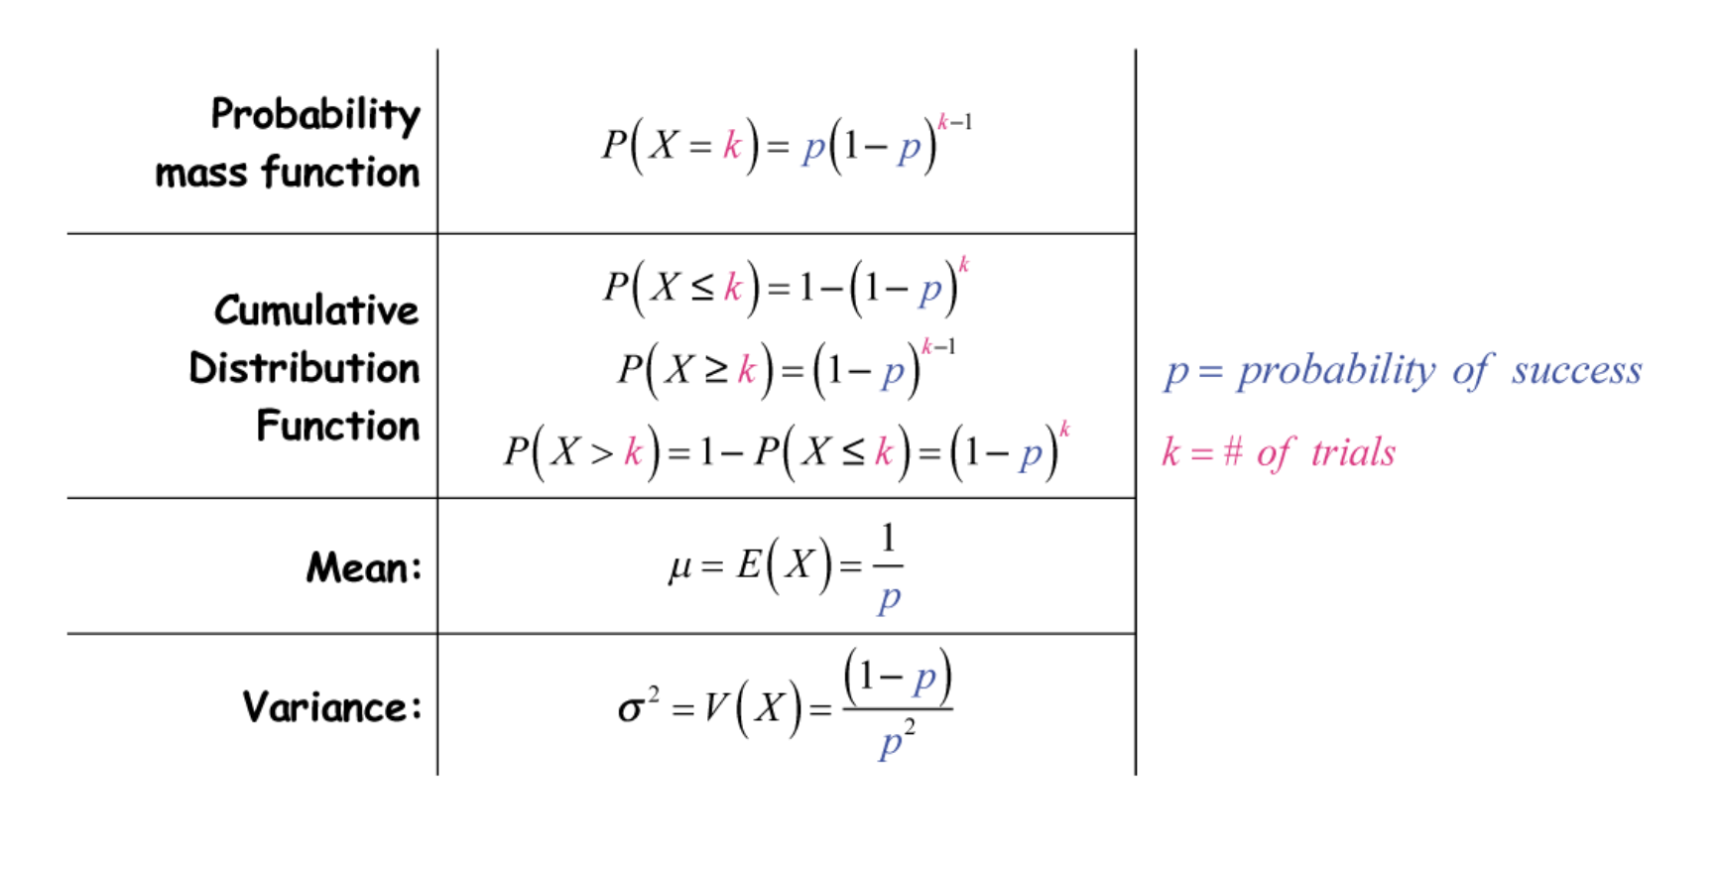
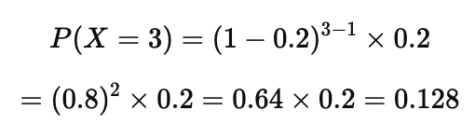
Geometric Distribution
Used to model the number of attempts until first success
20% chance of making a sale. How many meetings are needed until first sale?
How many meetings until a sale?
E(X) = 1 / 0.2 = 5
P(sale on 3rd meeting)

Slide 55
Mean and Variance of Geometric Distributed Data
P = probability of success per trial
Mean = E[X] = 1/p
Variance = (1-p)/p^2

Slide 56
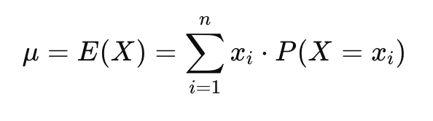
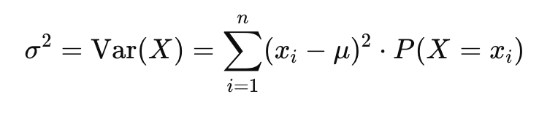
Summary Statistics For Discrete Distributions
Mean:
Variance:

